Slide 1
DSA 210 PROJECT REPORT
Steps Data Analysis: Comparing Physical Activity with Academic Periods

Slide 2
About My Project
The motivation for this project stems from a curiosity to better understand how my physical activity patterns fluctuate during school-related activities. Specifically:
Do I walk less during exam periods due to stress and time constraints?
Are vacations associated with higher physical activity due to more free time?
Do my physical activity in free time is enough or not? for a person to live a healthy life according to averages?
This project serves as a reflection on my lifestyle habits and encourages better health and time management during intense academic periods.

Slide 3
Data Source
Step Data: Collected from Apple Health, which automatically tracks daily step counts via my iPhone.
School Calendar: The dataset was manually created based on official school term dates, exam schedules, and vacation periods.

Slide 4
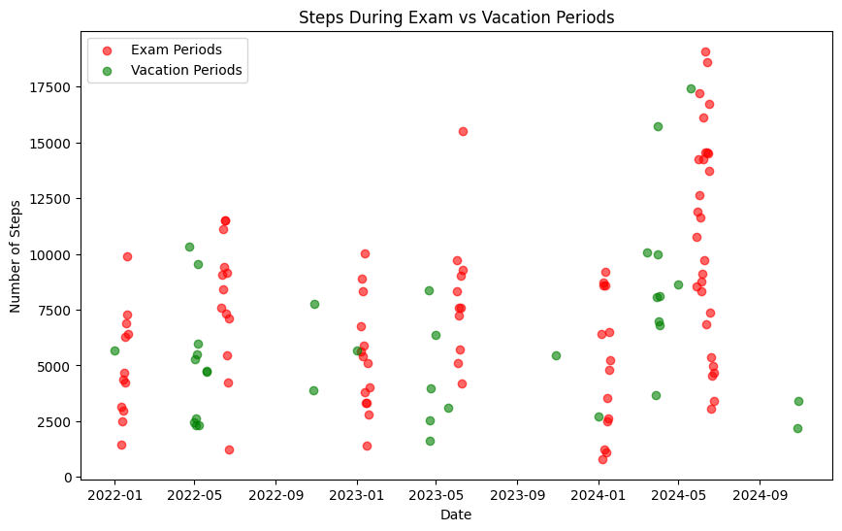
Findings
1) Exam Periods During exam weeks, step counts decreased significantly. This trend is likely caused by time constraints and reduced physical activity due to studying. Graph Type: Box Plot Observation: Median step counts during exam periods are visibly lower than the overall median step counts.

Slide 5
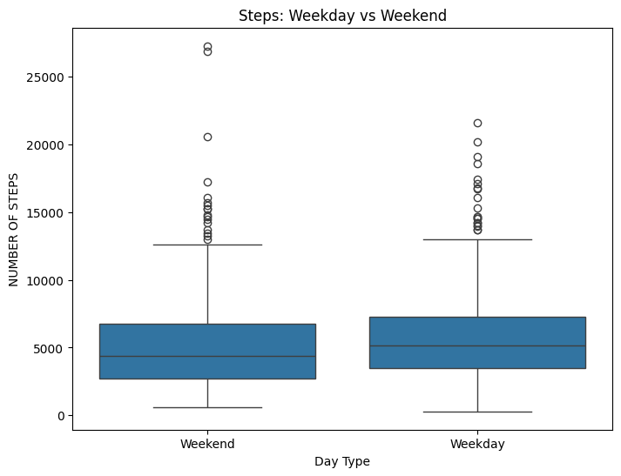
Findings
2) Vacation Periods Step counts were highest during vacation periods, reflecting more leisure time and increased opportunities for outdoor activities. Graph Type: Scatter Plot Observation: Vacation periods consistently show higher step counts compared to exam periods over time.

Slide 6
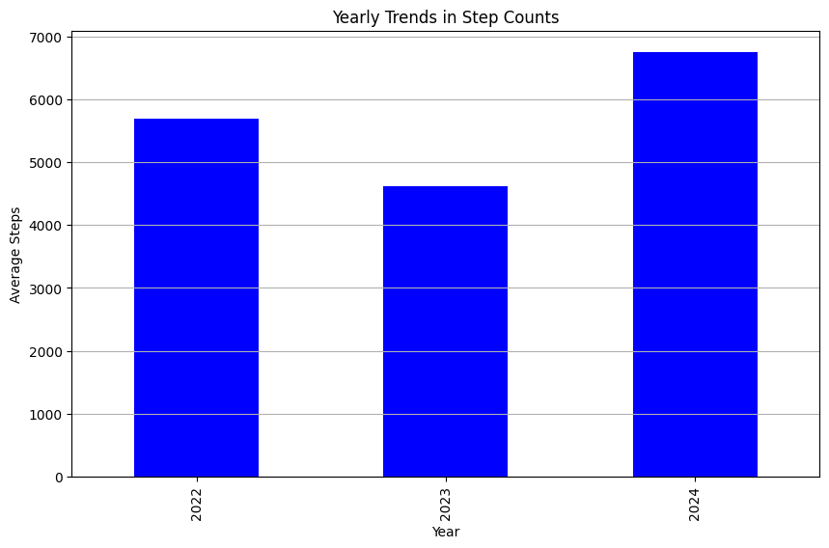
Findings
3) Weekday vs. Weekend Step counts were consistently higher on weekends compared to weekdays, even during academic terms, indicating increased free time and relaxation. Graph Type: Box Plot Observation: Weekends display higher median step counts and greater variability than weekdays.

Slide 7
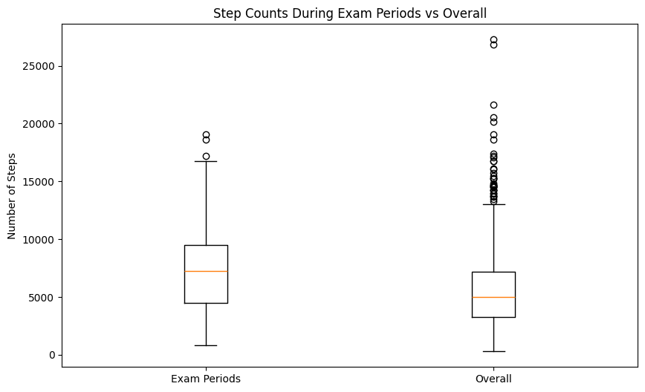
Findings
4) Yearly Trends Over three years, the overall step count increased steadily, showing a growing awareness of staying active. Graph Type: Bar Chart Observation: The yearly average step counts show an upward trend, with 2024 reaching the highest average.

Slide 8
Limitations
Limitations:
Data Gaps: Some times in a day had missing step data due to technical issues or not carrying my phone for example while actively playing sports, since I can not carry my phone with me in those times I do not have the data of the times in which I do sports actively. In addition to that I have been in military for one month during this summer and since I can not have my smartphone with me in those times I do not have the data for the time I have been in military.
Bias: Step data may not fully represent physical activity levels, as other activities (e.g., cycling or gym workouts) are not tracked.
Generalizability: Findings are personal and may not apply to others. For example I have been in erasmus in previous spring semester so my data in erasmus is completely different to my data in Istanbul.

Slide 9
Future Work
Incorporate Additional Data:
Track other health metrics like heart rate, sleep data, and stress levels to gain a more comprehensive view of my well-being.
Automation:
Use Python to automate data cleaning, analysis, and visualization for more efficient updates.
Comparison with Peers:
Collect similar data from friends or family to see if trends are consistent.
Behavioral Changes:
Use the insights gained to create healthier habits, such as planning regular walks during exam weeks or playing active sporgts during exam weeks or school periods.

